Slide 1
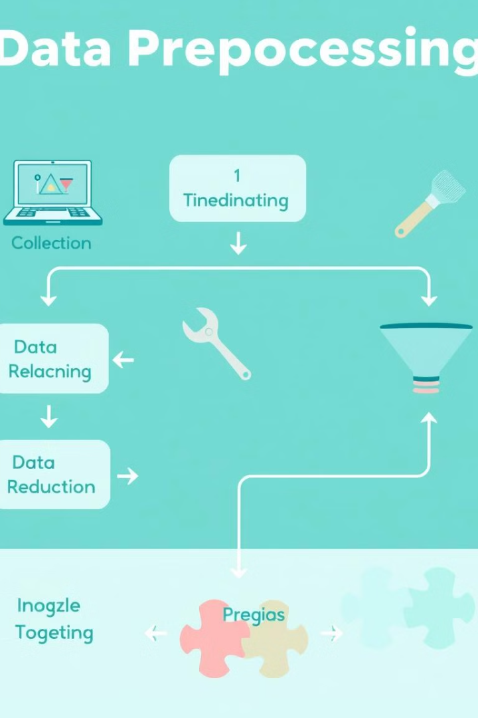
Data Preprocessing: Preparing Your Data for Success
Data preprocessing transforms raw data into an understandable format. It improves accuracy, efficiency, and model performance. Common techniques include cleaning, transformation, and reduction. Proper preprocessing is crucial for reliable results.
NK
by Naveen K

Slide 2
Step 1: Data Cleaning
Handling Missing Values
Removing Duplicates
Correcting Errors
Identifying and removing exact duplicates
Identifying and correcting typos
Deletion (when appropriate)
Using regular expressions and data validation
Imputation: Mean, Median, Mode, KNN Imputation
Handling near-duplicates (fuzzy matching)
Example: Correcting zip code formats
Example:
Example:
df.fillna(df.mean())
df.drop_duplicates()

Slide 3
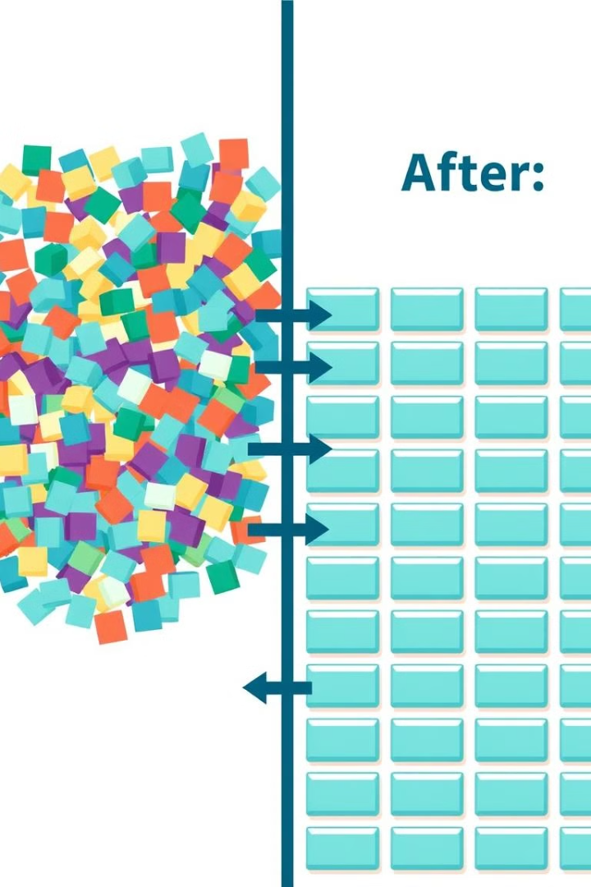
Step 2: Data Transformation
Scaling and Normalization
Min-Max Scaling and Standardization (Z-score) improve model performance.
Example:
MinMaxScaler().fit_transform(df)
StandardScaler().fit_transform(df)
Encoding Categorical Variables
One-Hot Encoding and Label Encoding convert categories into numerical data.
Example:
pd.get_dummies(df['category'])
LabelEncoder().fit_transform(df['category'])

Slide 4



Step 3: Data Reduction
Feature Selection
Identify the most relevant features. Techniques: Univariate Selection, Feature Importance, Correlation Matrix.
Dimensionality Reduction
Reduce features preserving information. Techniques: PCA, t-SNE
Selecting key features simplifies models and enhances interpretability. Reducing dimensions can visualize high dimensional data.

Slide 5

Code Example: End-to-End Data Preprocessing in Python
1
Loading Data
2
Applying Steps
3
Handling Data Types
Example:
Showcasing a complete pipeline using pandas and sklearn
df.select_dtypes
df = pd.read_csv('your_data.csv')
: selecting and processing different datatypes.

Slide 6
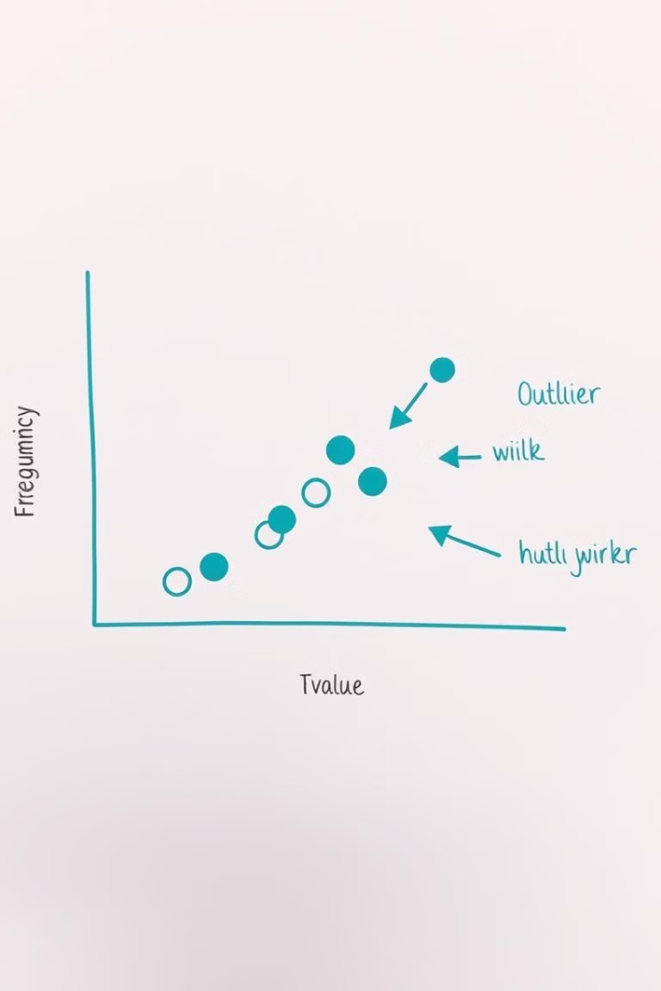


Advanced Techniques: Handling Outliers
Identifying Outliers
Dealing with Outliers
Box plots, scatter plots, and z-scores can help.
Trimming, capping, or transformation can be used.
Outliers can skew results. Use
np.clip
to cap outliers.

Slide 7

Libraries and Tools
Python
pandas, scikit-learn, numpy
R
dplyr, caret
Cloud Platforms
AWS SageMaker, Google Cloud AI Platform, Azure Machine Learning
These tools provide powerful functionalities for data preprocessing. Cloud platforms offer scalable environments.

Slide 8

Best Practices and Conclusion
Iterative Approach
Document Steps
Test techniques and find the best model.
Understand Your Data
Add comments to your code.
Perform describe() and explore the data.
Iterative testing and checks ensure data quality. Preprocessing is essential for data-driven models.

